Slide 1
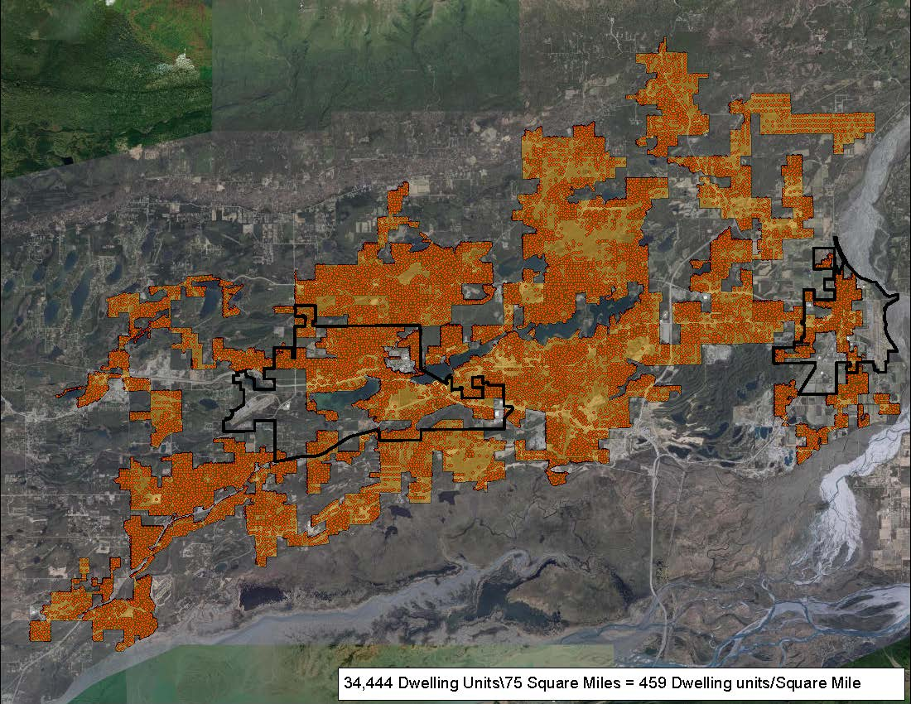
MPA Boundary Development
Potential Urbanized Area
12 Forecasts
(published 2005 – 2020)
“Each MPA shall encompass at least the existing urbanized area and the contiguous area expected to become urbanized within a 20-year forecast period” (23 CFR 450.312)

Slide 2
Population Forecasts
Inputs: existing, published forecasts from government and private institutions.
Recommendations from:
Steering Committee members
Borough Staff
ISER
Review of records and studies
12 Forecasts
(published 2005 – 2021)
Shortlist – 4 Forecasts

Slide 3
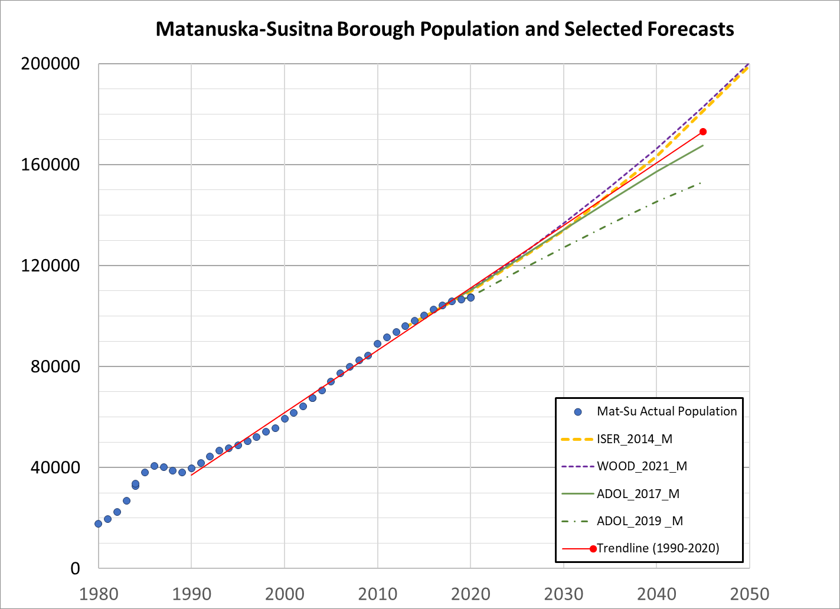
Shortlist – 4 Forecasts
W&P 2021 – 182.6k
ISER 2014 – 181.2k
ADOL 2017 – 167.5k
ADOL 2019 – 153.1k
Forecast | 2030 Estimate (thousands) | 2045 Estimate (thousands)
Woods & Poole 2021 | 136.7 | 182.6
ISER 2014 | 134.0 | 181.2*
ADOL 2017 | 134.1 | 167.5
ADOL 2019 | 127.1 | 153.1
*Interpolation from 2040 and 2050 estimates

Slide 4
Recommendations – MSB Forecast
The Planning Division recommends the ADOL 2017 forecast for selection of the MPA Boundary
High confidence that ADOL will continue to update forecasts
ISER plans to use ADOL forecasts going forward; Mat-Su Borough staff uses ADOL forecasts;
the MoA selected an ADOL forecast for their 2017 Anchorage 2040 Land Use Plan.
The ADOL 2017, Woods & Poole 2021, and ISER 2014 forecasts are essentially equal until 2030
The MPO Boundary can be adjusted as needed, and is adjusted after every census

Slide 5
Minimum Boundary Requirement
Census Bureau released Urban Area Criteria for the 2020 Census on March 24
Main criteria for an Urbanized Area, defined by Census Blocks:
Urban core of at least 425 housing units per sq. mi.
Plus contiguous Census Blocks @ 200 housing units per sq. mi.
People per Square Mile | Housing Units per Square Mile (Nat’l Avg.: 2.6 residents per unit) | People per Acre (1 mi² = 640 acres)
500 | 200 | 0.8
1000* | 385 | 1.6
1100 | 425** | 1.7
*1000 people per square mile was the 2010 Census metric for core area
**425 households per square mile is the 2020 Census metric

Slide 6
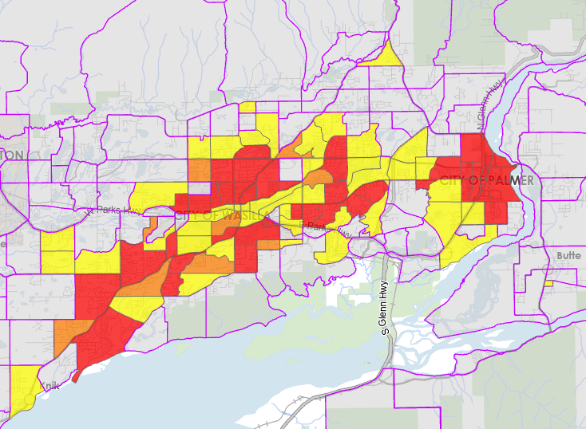
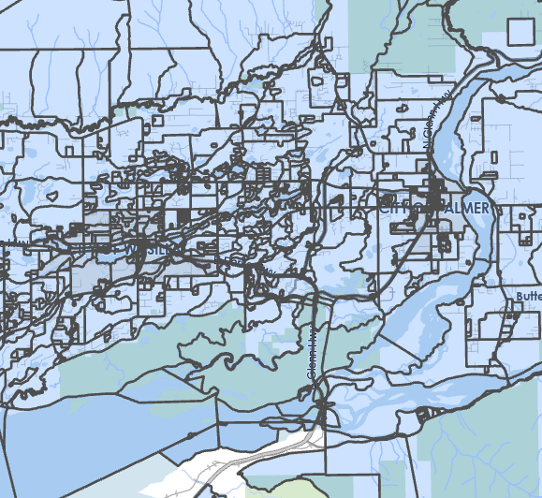
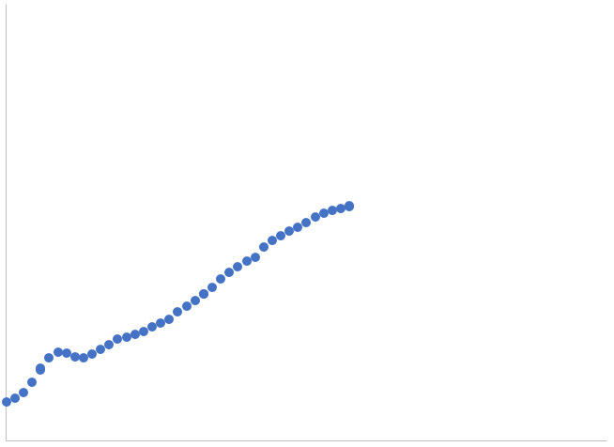
Minimum Boundary Methodology
Part 1 - Forecast
AMATS Forecast
Created 2013
Census Block Boundaries
Distribute
Re-Map
2045
Core density (1100 p/mi²)
Peripheral density (500 p/mi²)
MSB Total Population Forecast
Selected by Steering Committee
Travel Demand Model
Spatial Distribution Forecast
Output
Best-Guess 2045 Density

Slide 7
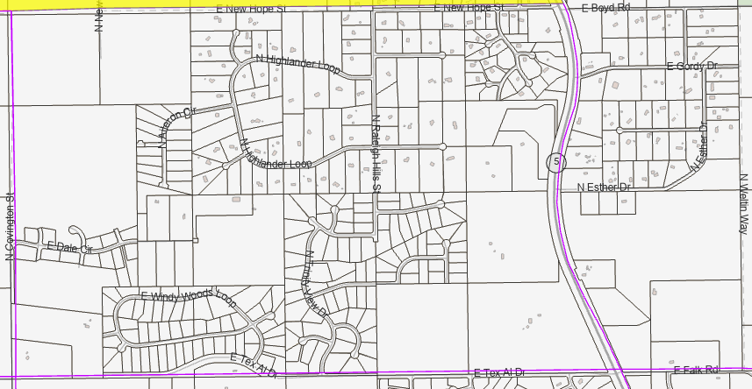
Minimum Boundary Methodology
Minimum Boundary Methodology
Part 2 – Facts on the Ground
AMATS Forecast
Created 2013
The AMATS forecast does not always match Facts on the Ground
For example, it does not predict Fishhook subdivision
But since 2013 there has been significant activity
Actual Subdivision
2022
Along with the AMATS forecast,
Planning is preparing
maps of current development for the Steering Committee.
Core density (1100 p/mi²)
Peripheral density (500 p/mi²)

Slide 8
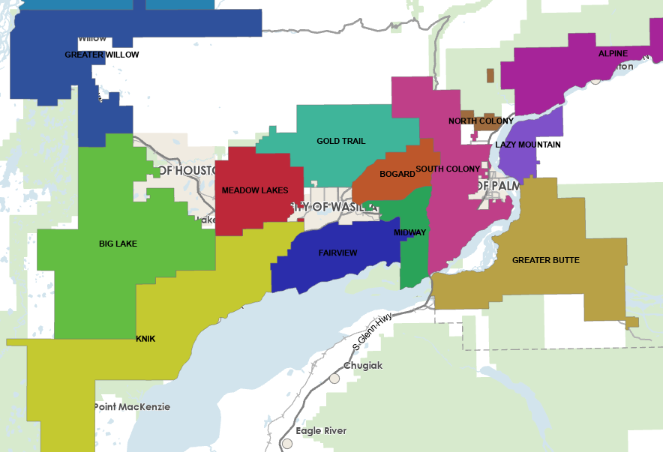
Other Boundary Considerations
Practical boundary alignment?
RSAs
Employment & recreation destinations
Assembly Districts
MSB Road Service Areas

